Slide 1

Colorify
Denald Demirxhiu
https://github.com/denalddemirxhiu/Colorify

Slide 2
Introduction
Purpose of this project
Problems
Graphic designers have no way to access colours found in the real world
Obtaining colours via images is cumbersome and requires extra work
Sensor
ISL29125 RGB Colour sensor
Purpose
Read color values from the environment seamlessly
Utilize the colour readings to display them in RGB, HEX formats useful for designers
Readings could be used to balance the color temperature for displays or other devices

Slide 3
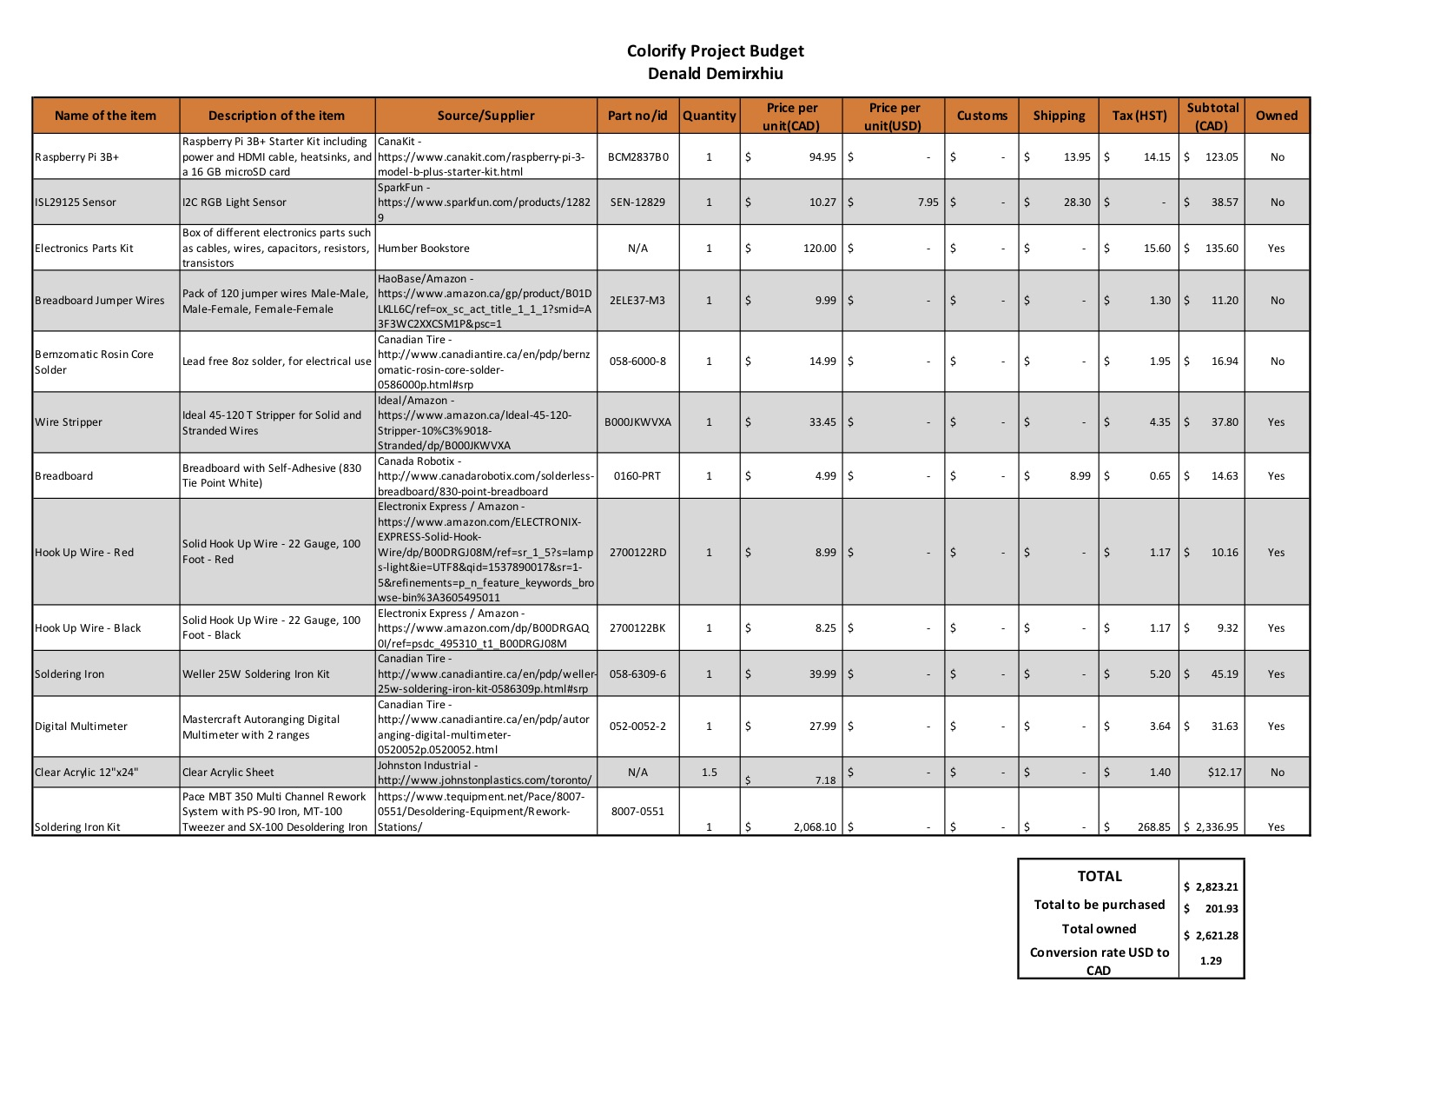
Budget

Slide 4
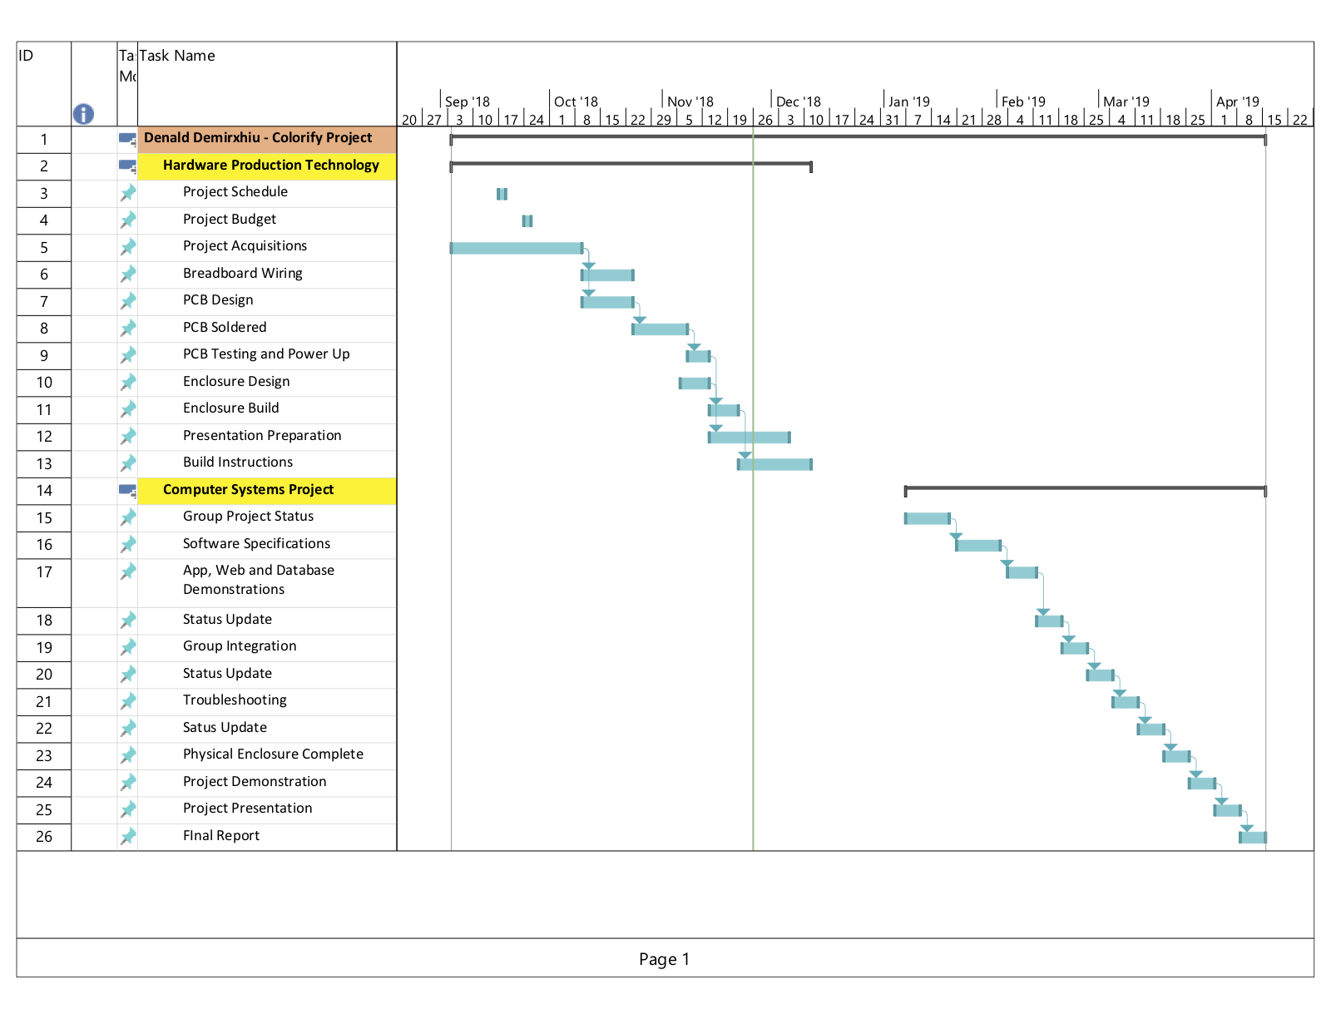

Schedule
Schedule was followed according to the plan
There were problems with the PCB design which was followed with a week setback
The solution allowed the project to go back on schedule

Slide 5
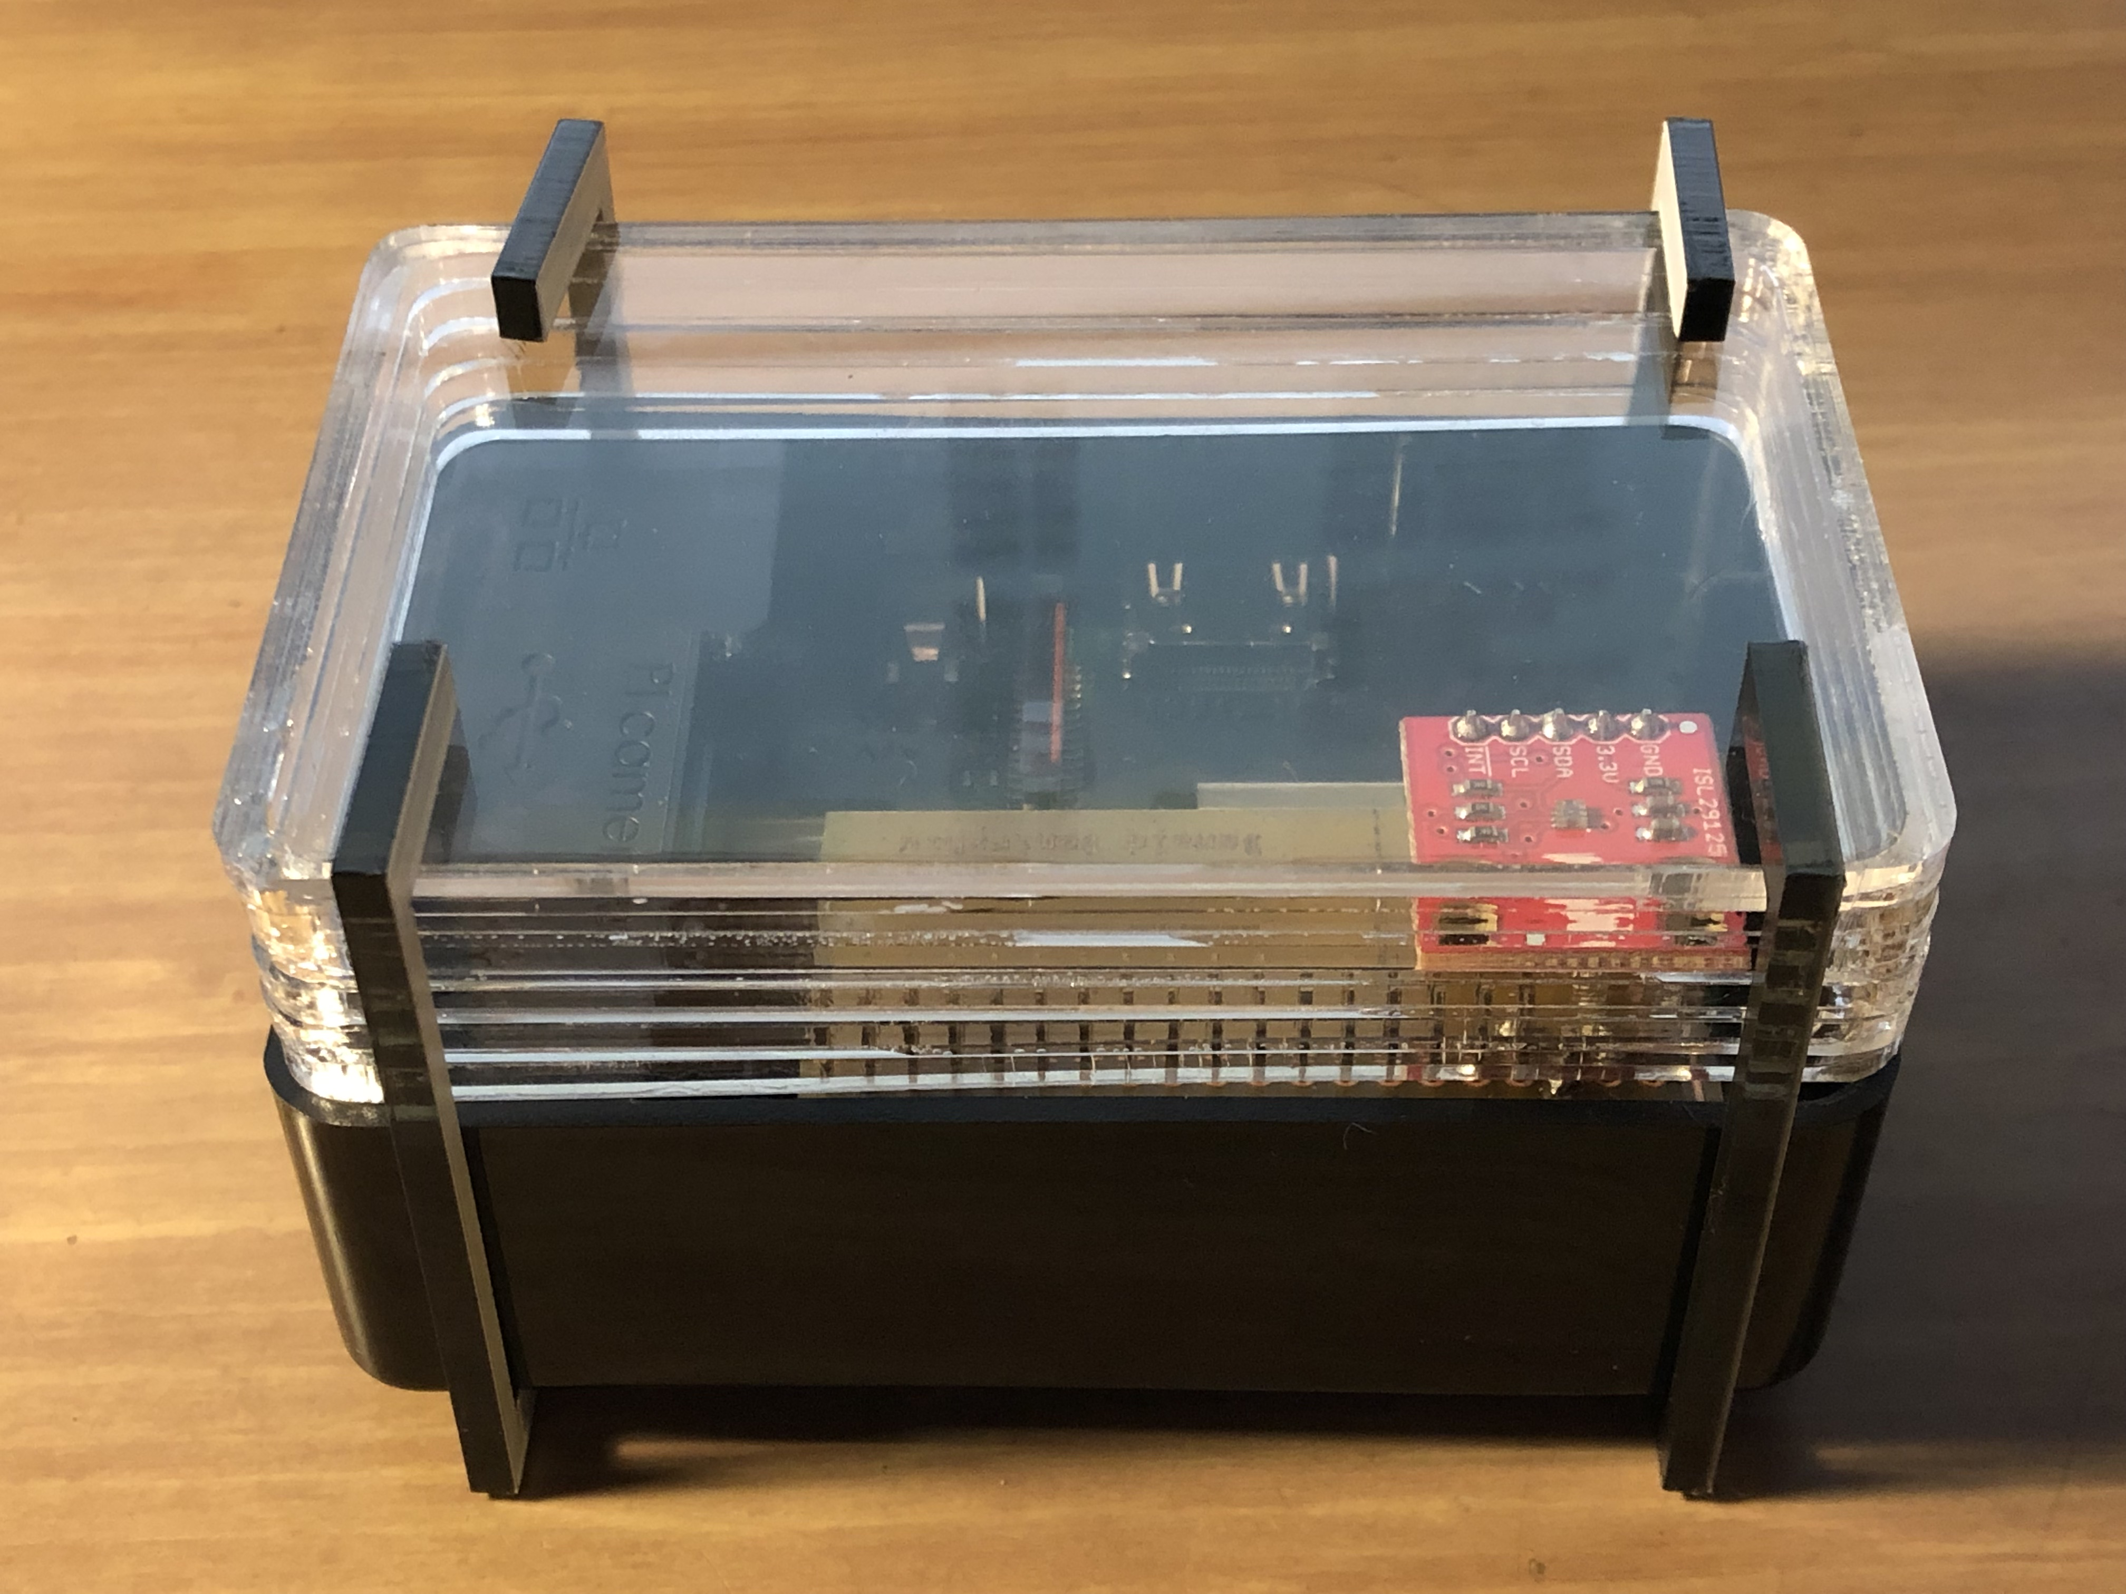
Completed Project with Enclosure

Slide 6
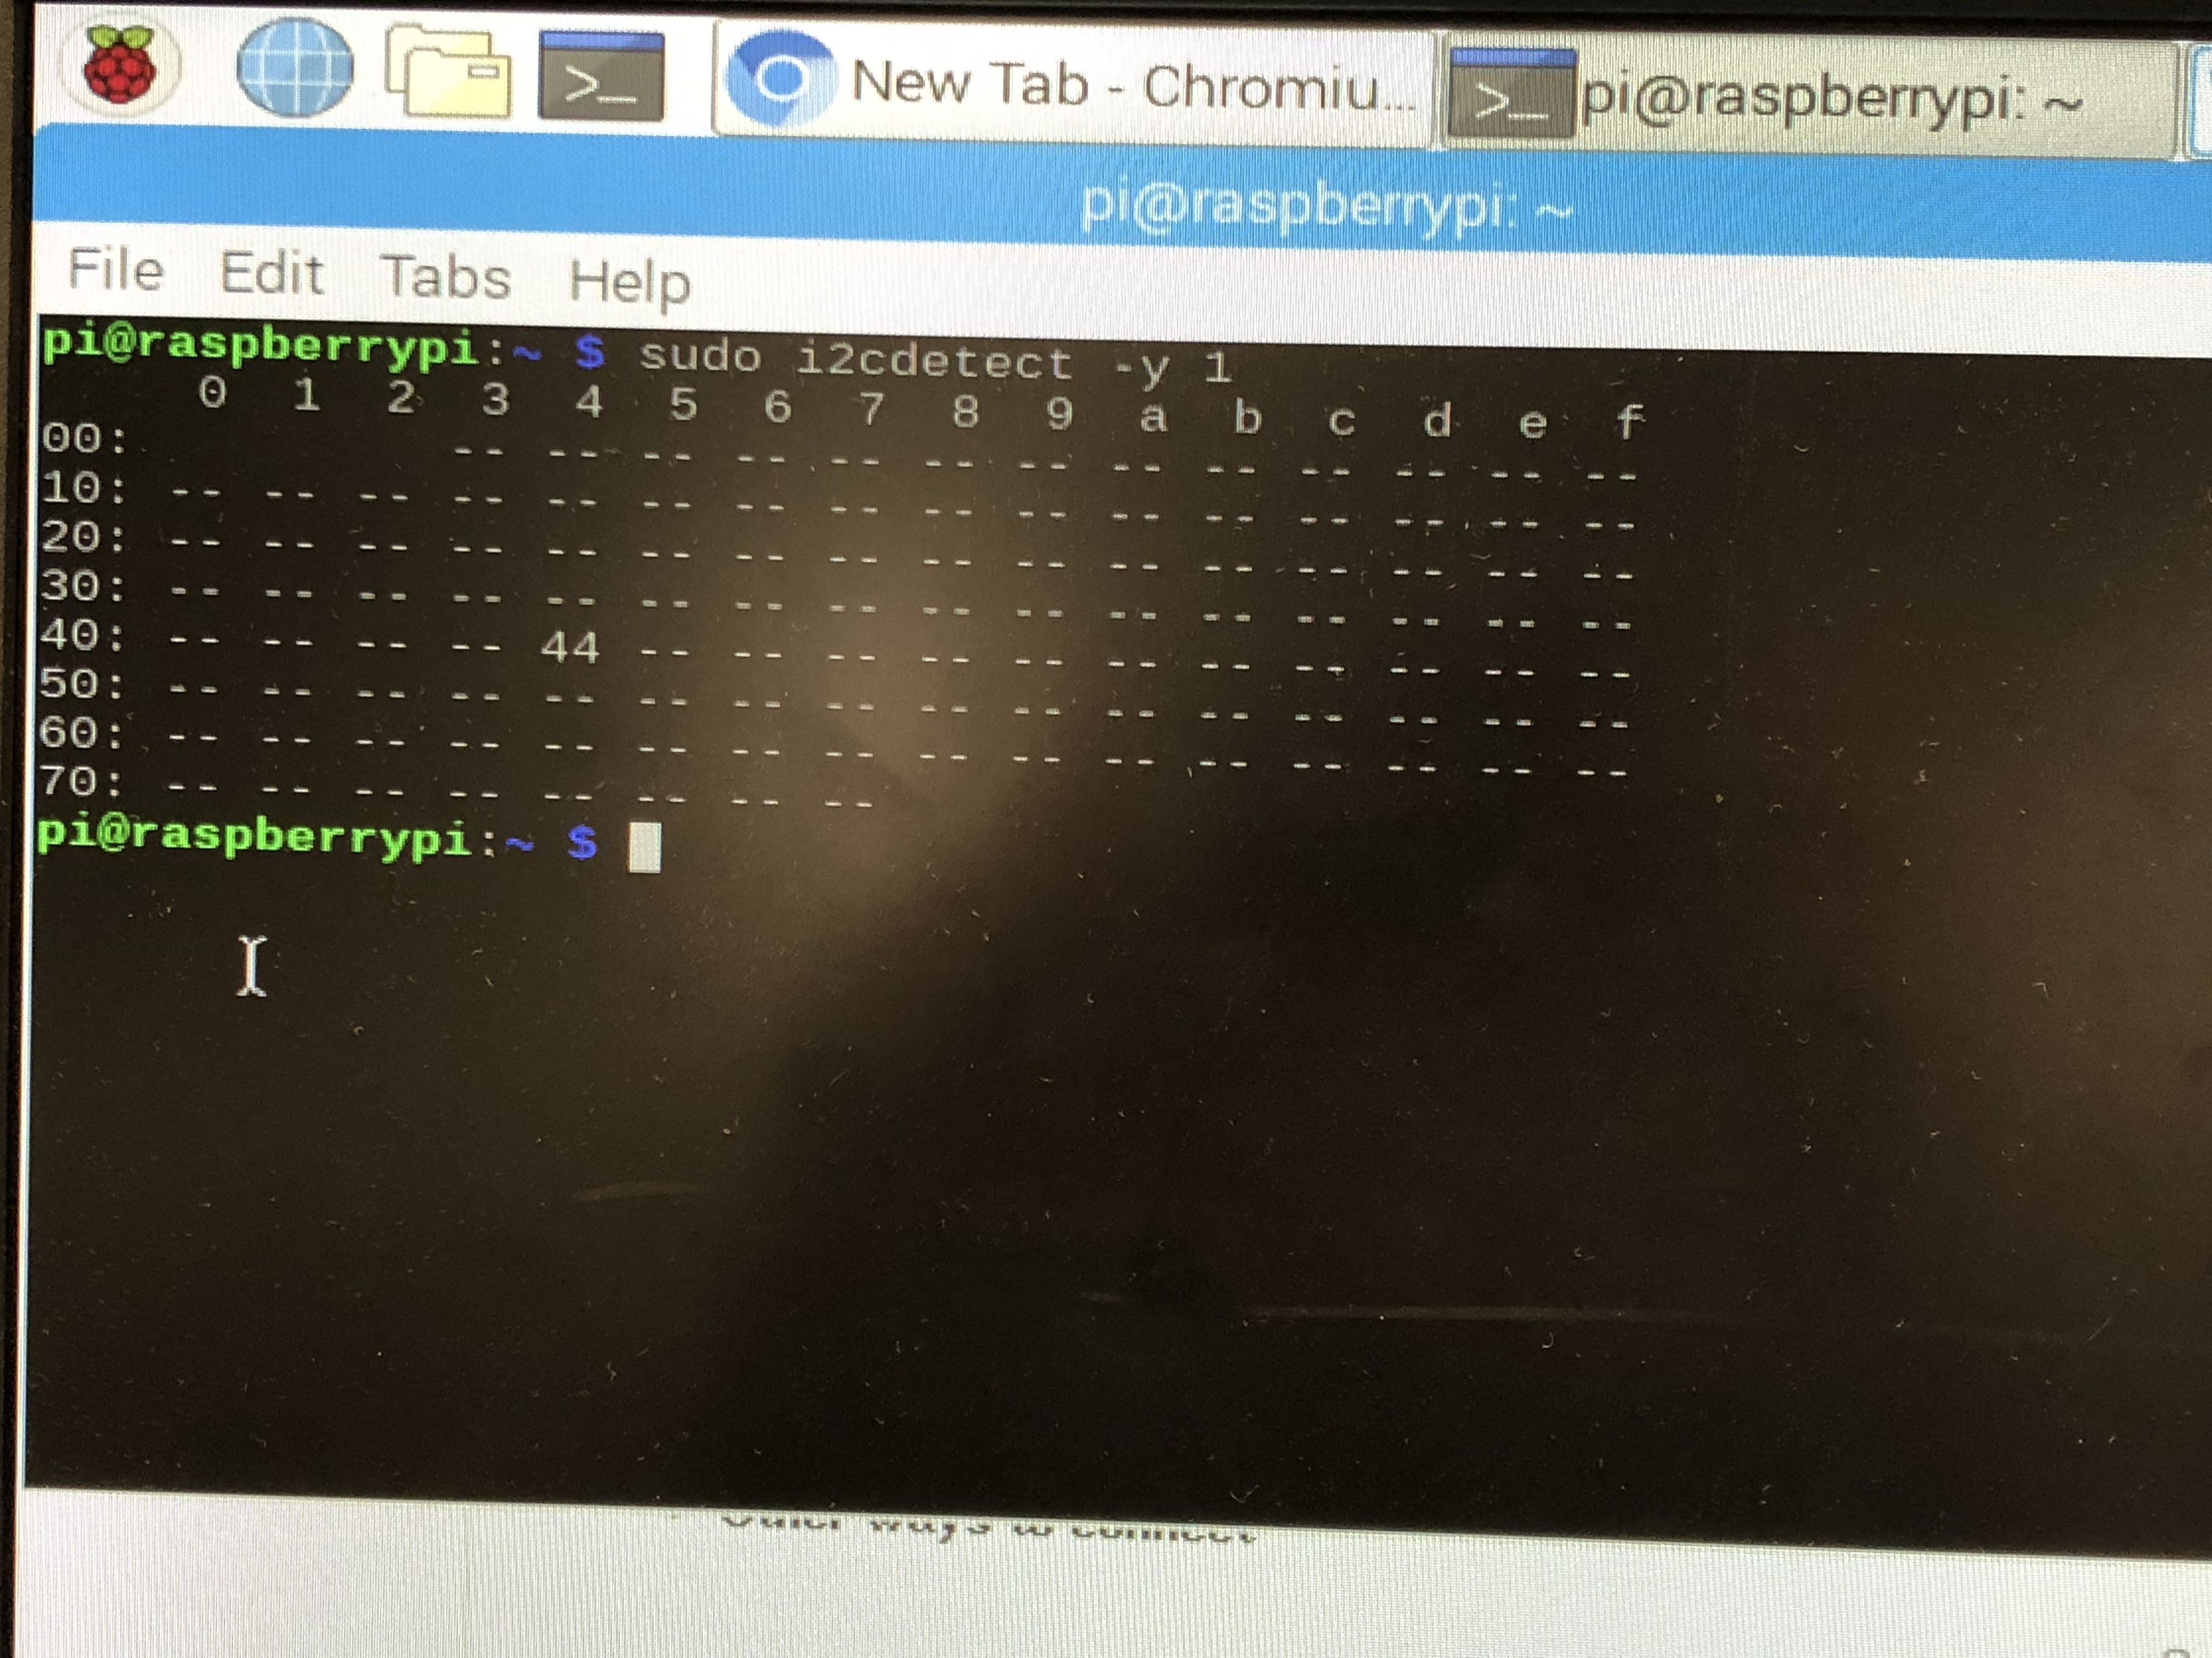
Image capture of the address

Slide 7
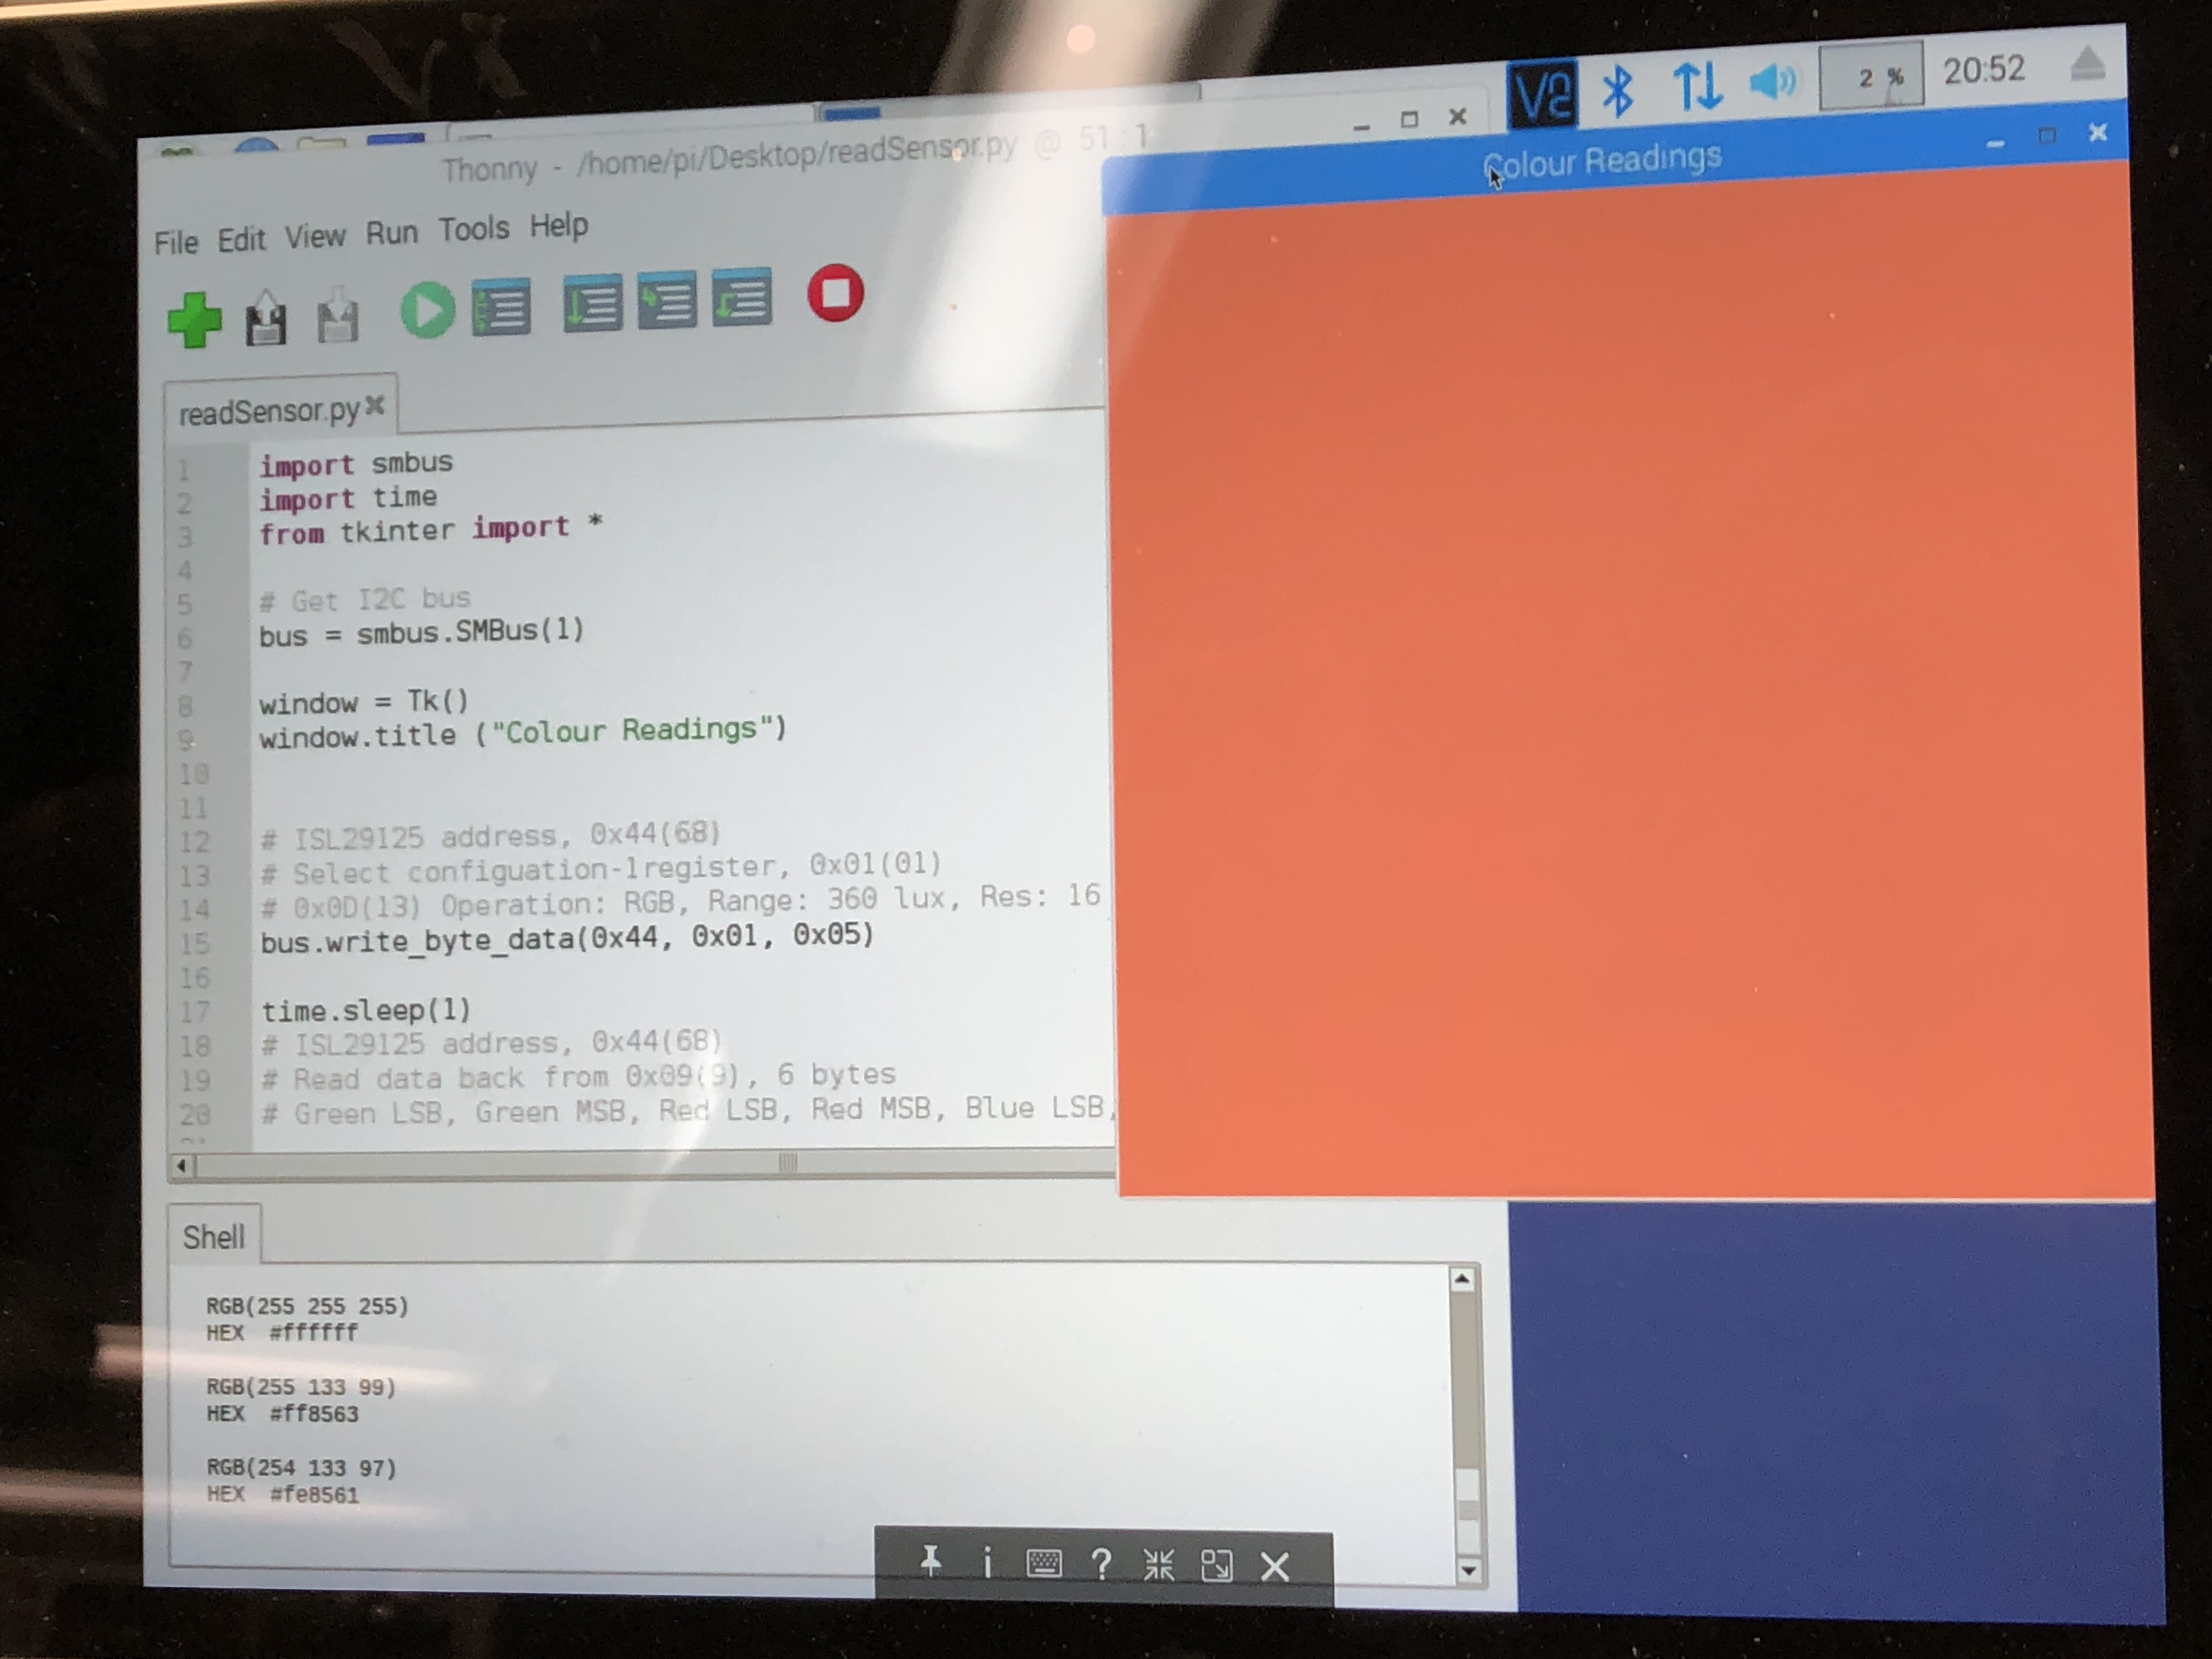
Reading from the Colour Sensor

Slide 8
Courses useful for this project
Electronic Circuits (Tech 101) & Digital and Interface Systems (CENG 215)
Helped with breadboarding and circuitry
Technical C (TECH 153) & Embedded Systems (CENG 252)
Helped with programming knowledge, microcontroller systems knowledge, i2c interfacing
WRIT 120 & WRIT 220
Helped with project reports and documentation

Slide 9
Thank You

